Slide 1

BEGINNER TO EXPERT GUARANTEED
OPERATING SYSTEM COURSE
ACCESS MORE COURSES PLAYLIST LINK IN DESCRIPTION
SUBSCRIBE!!!

Slide 2
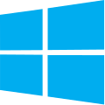
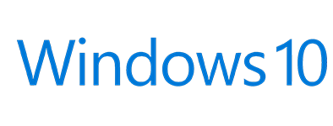
TOPICS
Introduction to Operating System or Windows 10
Windows 10 Installation and Highlighted Features
Getting Friendly with Interface & Basic Operations
User Management in Windows 10 Operating System
Shrinking & Extending Hard Disk Drive Partitions
Filesystem (NTFS & FAT32) Partition Style (MBR & GPT)
Windows Firewall & Windows Defender Security
Uses of Command Line Terminals in Windows 10
Disk Defragmentation & Disk Cleanup Utilities in OS
Registry Editor & system32 Folder Importance in OS
Antivirus & Malwares Full Information with Roles
Policies & Services in Operating System Windows 10
Task Manager & RUN in Operating System Windows 10
Connecting to Internet all basic information you need
Connecting in Network & Sharing File using Network
Remote Desktop Connection & Windows Remote Assist.
Basic Understanding of Computer terms (FPS, dpi & RPS)
Backup & Restore Importance in OS with Practical
Migration of data Importance in OS with Practical
What is Binary or Machine Language full information

Slide 3
Introduction to Operating System or Windows 10

Slide 4
Operating System
The operating system is the most important program that runs on a computer.
Operating system is an interface between computer and user.
It is responsible for the management and coordination of activities and the sharing of the resources of the computer.

Slide 5
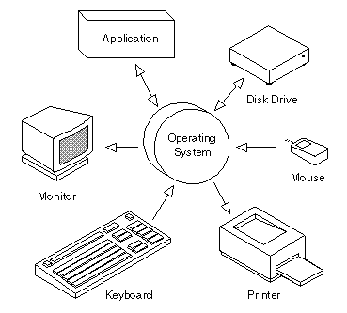

Slide 6
Operating System
NOS
COS
MS Windows 2012 Server
MS Windows 2016 Server
MS Windows 2008 Server
Linux
UNIX Based
Netware
MS Windows 10
MS Windows 8.1
MS Windows 7
MS Windows XP
MS DOS
Android

Slide 7
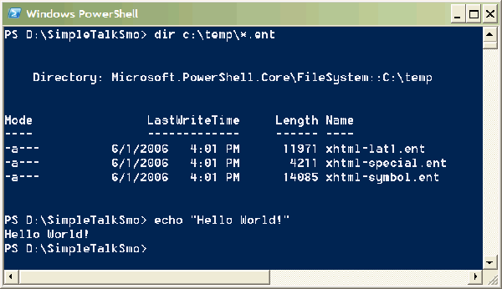
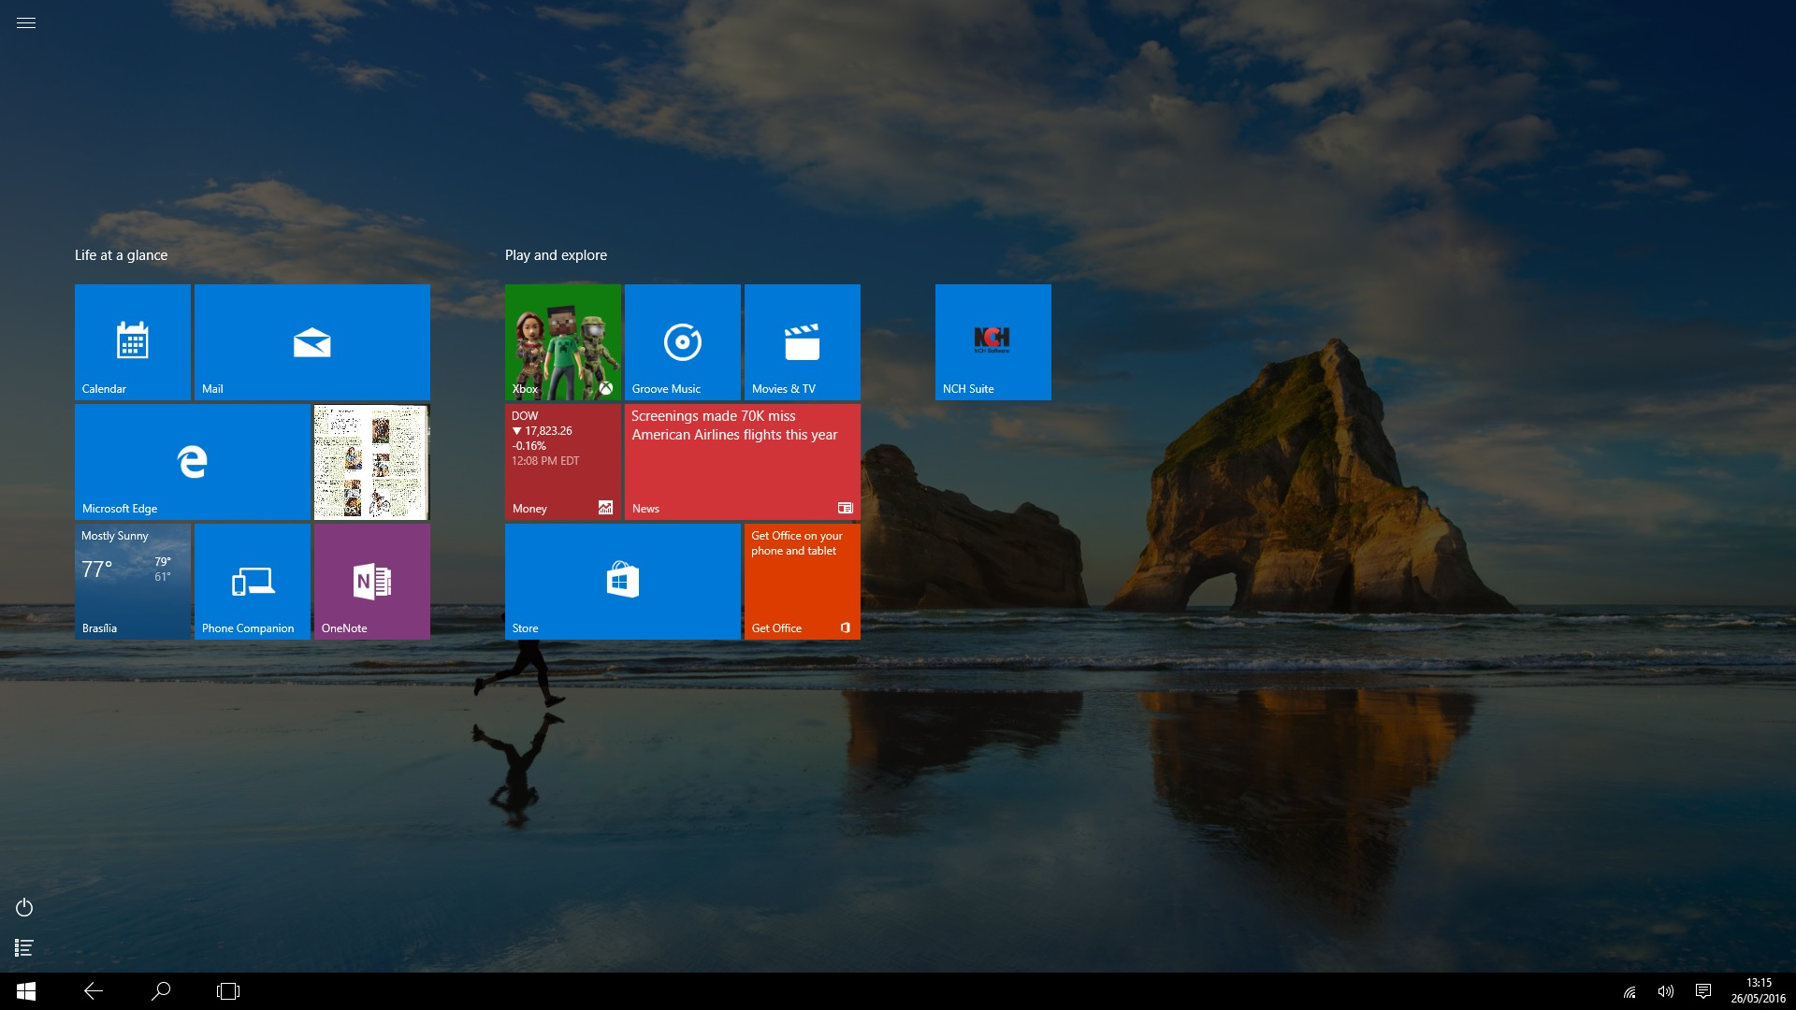
Types of User Interface
Command line interface
Graphical user interface
Command Line Interface (CLI)
Graphical User Interface (GUI)

Slide 8
Examples of Operating System
MS-DOS
Windows
Mac OS
Linux
Solaris
Android

Slide 9
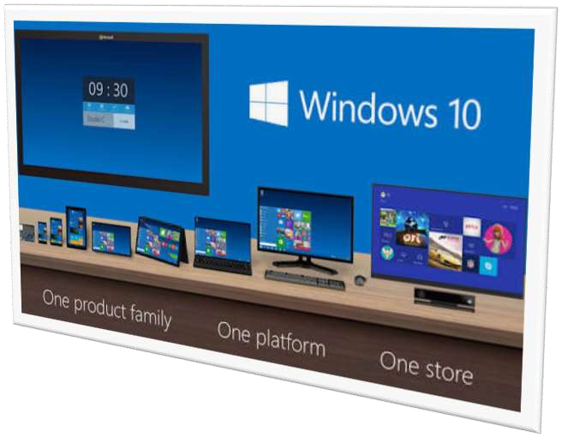
INTRODUCTION WINDOW 10
Developed by Microsoft
Frist presented in April 2014 at the build Conference
Scheduled to be released in late 2015
FREE upgrade to Window 10
Goal of Window 10 is to unify the Window pc, Window phone, Window Embedded and Xbox one product families, Surface Hub and HoloLens, etc.

Slide 10
SYSTEM REQUIREMENTS
Processor
RAM
Free hard disk space
Graphics card
: 1 Ghz or Faster
: 1 GB (32-bit) or 2 GB (64 bit)
: 16GB
: Microsoft DirectX 9 graphics device

Slide 11
Let’s Download Windows 10 Image ISO

Slide 12
2. Windows 10 Installation and Highlighted Features

Slide 13
Let’s Install Windows 10

Slide 14
NEW FEATURES
Start Menu
Cortana
Edge Browser
Improved Multitasking
Advanced Settings
App Store
X-Box Gaming
OneDrive
Hyper-V

Slide 15
3. Getting Friendly with Interface & Basic Operations

Slide 16
4. User Management in Windows 10 Operating System

Slide 17
Users in Windows 10
Administrator :- The administrator controls the entire computer, deciding who gets to play with it and what each user may do on it. On a computer running Windows, the owner usually holds the almighty Administrator account.
Standard :- Standard account holders can access most of the computer, but they can’t make any big changes to it. They can’t run or install new programs, for example, but they can run existing programs.
Child :- The Child account setting is actually just a Standard account with the Family Safety settings automatically turned on.
Guest :- Guests can play with the computer, but the computer doesn’t recognize them by name. Guest accounts function much like Standard accounts but with no privacy: Anybody can sign in with the Guest account, and the desktop will look the way the last guest left it.

Slide 18
5. Shrinking & Extending Hard Disk Drive Partitions

Slide 19
Disk Management
Shrink :- Shrink means Concatenating Unallocated space within the selected drive.
Extend :- Extend means Making a new partition from the selecting drive.
Label :- Label refers to the name of the partition drive seems like drive name.
Format :- Process of Cleaning up the drives for fresh use is known as format.
Drive Letter :- Drive Letter refers to the primary identification of partition by letters.

Slide 20
6. Filesystem (NTFS & FAT32) Partition Style (MBR & GPT)

Slide 21
Definition
Definition :- Computers use particular kinds of file systems to store and organize data on media, such as a hard drive, the CDs, DVDs, and BDs in an optical drive. Any place that a PC stores data is employing the use of some type of file system. A file system can be thought of as an index or database containing the physical location of every piece of data on a hard drive. A file system is setup on a drive during a format.

Slide 22
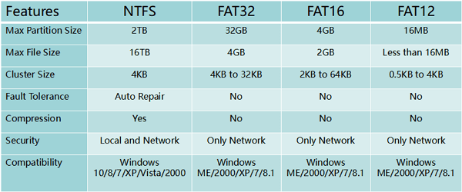
Types of File Systems
FAT File System
NTFS File System

Slide 23
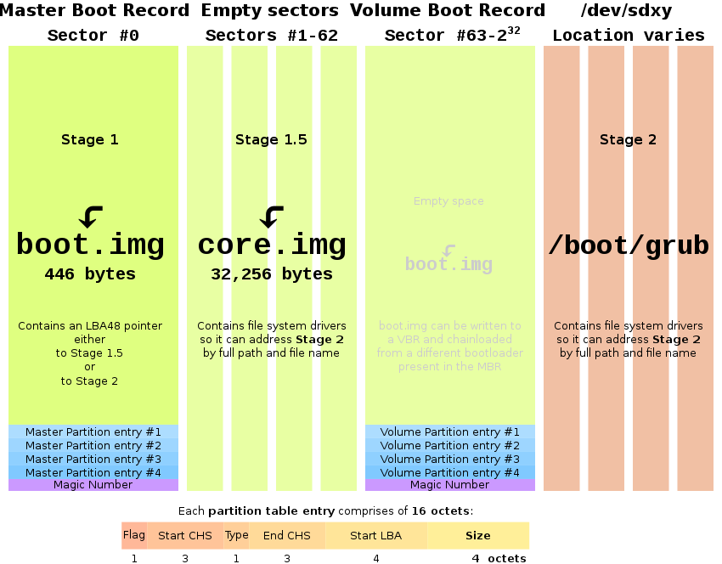
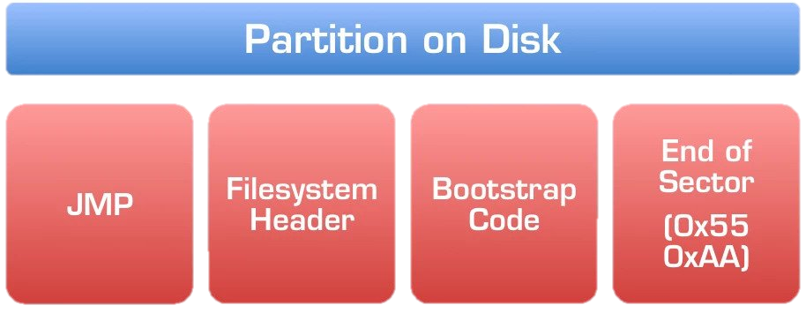
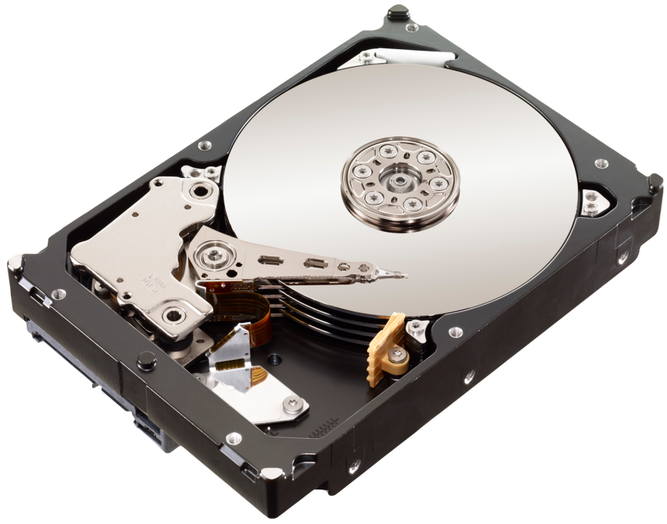
Boot Record?

Slide 24
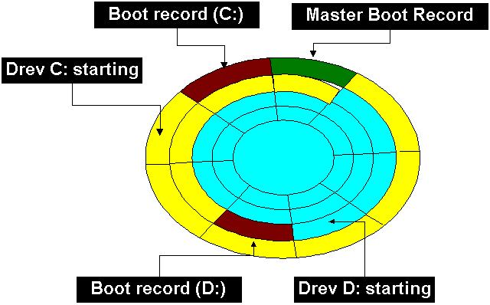

Slide 25
Master Boot Record (MBR)
The Master Boot Record (MBR) is the information in the first sector of any hard disk that identifies how and where an operating system is located so that it can be loaded into the computer's main storage or random access memory.
It is Standard Signature of Drive Partition
It lies on the Difference of Partition of Media
Not more than 2 TB HDD are allowed
Not more than 4 Primary Partition allowed
Uses in Legacy & UEFI BIOS Both
MBR is Ideal upto Windows 7 OS

Slide 26
Global Partition Table (GPT)
GPT is a newer standard that’s gradually replacing MBR.GPT, in turn, replaces the old MBR partitioning system with something more modern. It’s associated with UEFI. It’s called GUID Partition Table because every partition on your drive has a “globally unique identifier.
It is Standard Signature of Drive Partition
It lies on the Difference of Partition of Media
More than 8 ZB HDD are allowed as Storage
More than 128 Primary Partition allowed in GPT
Uses in UEFI BIOS only
GPT is Ideal for Windows 10 or Latest Operating System

Slide 27
7. Windows Firewall & Windows Defender Security

Slide 28
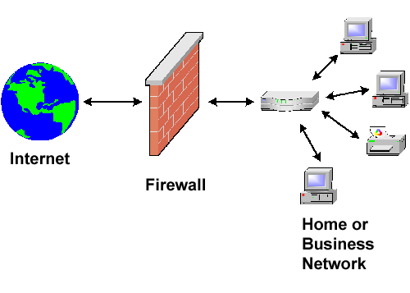
What is a Firewall?
A firewall is a network security device, either hardware or software-based, which monitors all incoming and outgoing traffic and based on a defined set of security rules it accepts, rejects or drops that specific traffic.
Accept : allow the traffic Reject : block the traffic but reply with an “unreachable error” Drop : block the traffic with no reply
Firewall Working
A firewall establishes a barrier between secured internal networks and outside untrusted network, such as the Internet.

Slide 29
Host-based firewall vs Network-based firewall?
A host-based firewall is installed on an individual computer to protect it from activity occurring on its network.
A network-based firewall is implemented at a specified point in
the network path and protects all computers on the “internal” side of the firewall from all computers on the “external” side of the firewall.

Slide 30
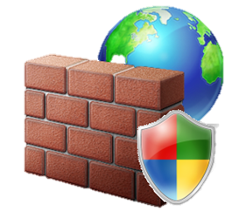
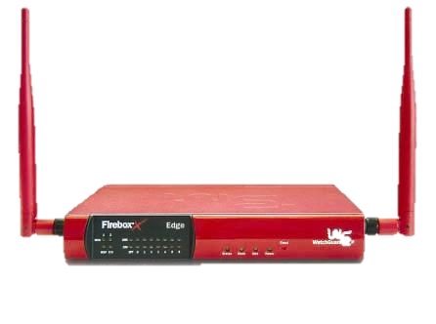
Hardware firewall vs Software firewall
Hardware firewalls are integrated into the router that sits between a computer and the Internet.
Software firewalls are installed on individual servers. They intercept each connection request and then determine whether the request is valid or not.

Slide 31
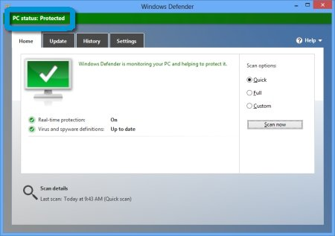
What is a Windows Defender?
Microsoft Defender is antivirus software developed by Microsoft to protect computers running Windows. It detects and removes viruses, spyware, and malware, helping to protect the operating system from infection.

Slide 32
8. Uses of Command Line Terminals in Windows 10

Slide 33
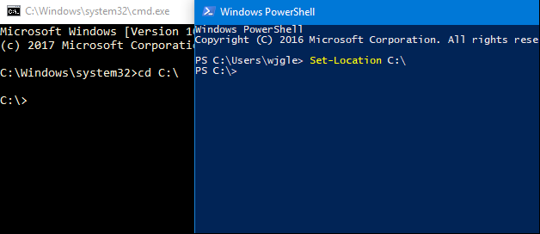
What is a CLI?
CLI is a command line program that accepts text input to execute operating system functions. In the 1960s, using only computer terminals, this was the only way to interact with computers. In the 1970s an 1980s, command line input was commonly used by Unix systems and PC systems like MS-DOS and Apple DOS.
CMD
POWERSHELL

Slide 34
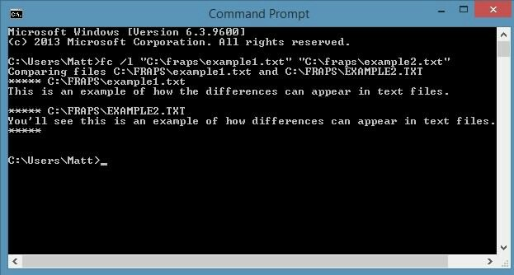
CMD

Slide 35
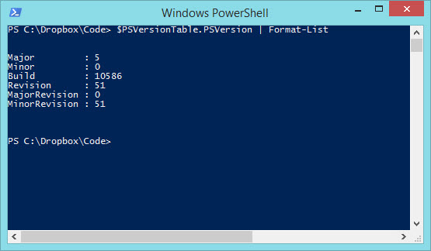
POWERSHELL

Slide 36
9. Disk Defragmentation & Disk Cleanup Utilities in OS

Slide 37
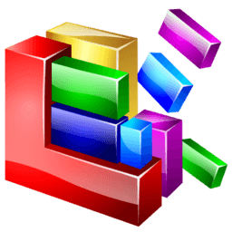
INTRODUCTION
Defragmentation :- is like cleaning house for your server or PC, it picks up all of the pieces of data that are spread across your hard drive and puts them back together again. Why is defragmentation important? Because every computer suffers from the constant growth of fragmentation and if you don’t clean house, your server or PC suffers.
Disk fragmentation :- occurs when a file is broken up into pieces to fit on the disk. Because files are constantly being written, deleted and resized, fragmentation is a natural occurrence.

Slide 38
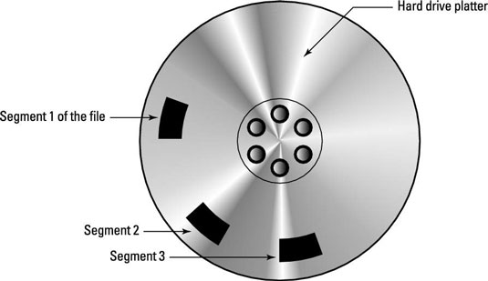

Slide 39


INTRODUCTION
Disk Cleanup is a Windows maintenance utility. This utility is designed to free up disk space on a computer hard drive. The way Disk Cleanup works is by scanning and analyzing the hard drive to see if there are files that are no longer needed. Disk Cleanup then removes the unnecessary files and frees up more available space.

Slide 40
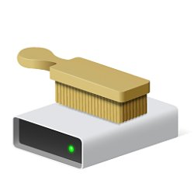
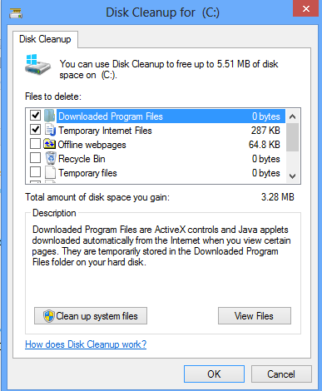
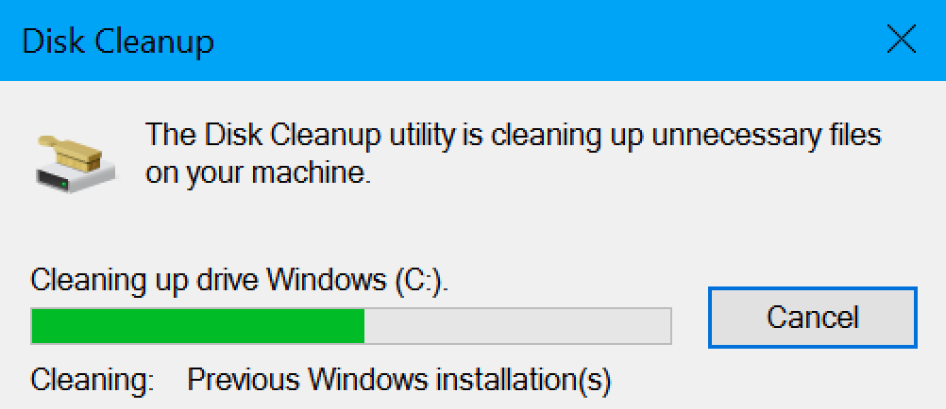

Slide 41
Some Ways to Clean Disks
Uninstall Extra Non Useful Programs
Use Disk Cleanup
Use to Delete PREFETCH Files
Use to Delete RECENT Files
Use to Delete TEMPORARY Files
Use to Delete PACKAGE Files
3rd Party Software for Deleting Duplicates
Use Storage Sense in Windows 10

Slide 42
10. Registry Editor & system32 Folder Importance in OS

Slide 43
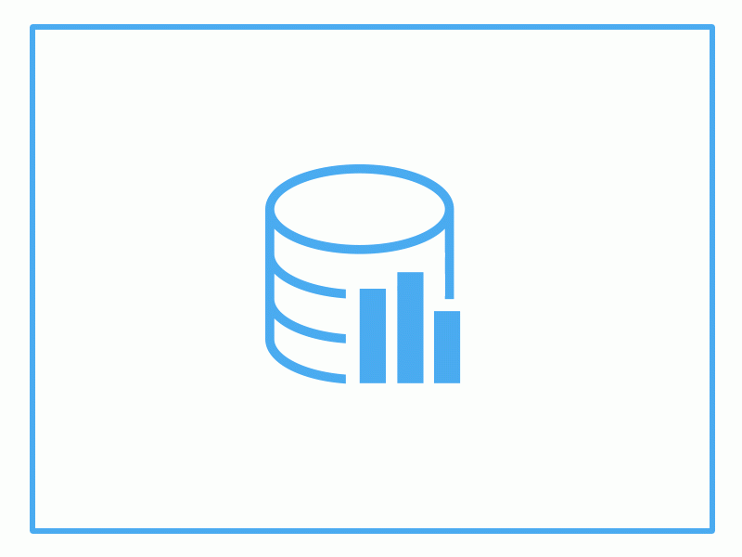
INTRODUCTION
The Windows Registry is a database of settings used by Microsoft Windows. It stores configurations for hardware devices, installed applications, and the Windows operating system. The Registry provides a centralized method of storing custom preferences for each Windows user, rather than storing them as individual .

Slide 44
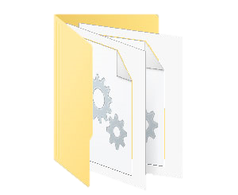
System32 Folder
System32 contains important operating system files that Windows needs in order to function properly. This directory contains many different types of files, but DLL and EXE are some of the most common types you’ll find if you start digging through the folder. Dynamic Link Library (DLL) files are shared library files used by Windows programs
system32

Slide 45
11. Antivirus & Malwares Full Information with Roles

Slide 46
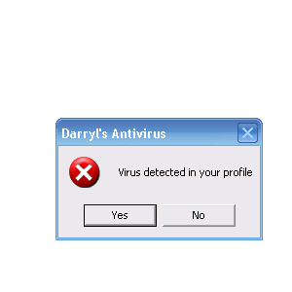
INTRODUCTION
Malware is a malicious software that gets installed in your device and performs unwanted tasks. Mainly designed to transmit information about your web browsing habits to the third party

Slide 47
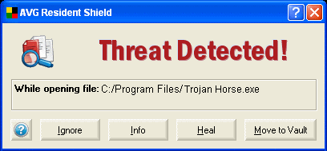
Types of Malwares
Viruses
Spyware
Adware
Scareware
Worms
Trojan Horse
Spam
Rootkits

Slide 48
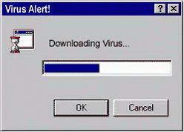
Viruses
Software that replicates itself and spreads by damaging and deleting the files.
Virus enters your device via attached images, greeting, audio/video files , downloads etc.

Slide 49
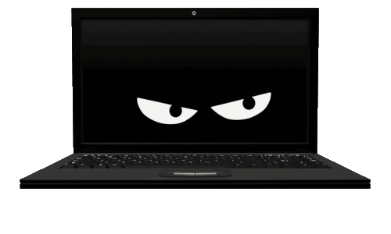
Spyware
Spyware is a program that gets installed without the user’s permission.
It monitors the user’s activities on the internet and transmits that information to the third party.

Slide 50

Adware
Software where advertising banners are displayed while any program is running.
It automatically downloads to your device while browsing any website
It is used by companies for marketing purposes

Slide 51
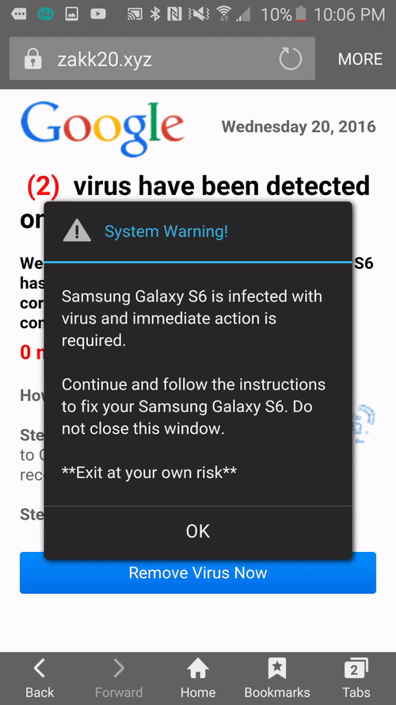
Scareware
Software that is designed to trick the user into buying or downloading unwanted software.

Slide 52
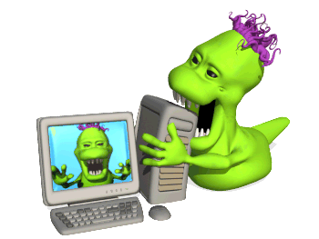
Worms
Malicious program that make copies of itself on local device, network shares etc.
They make the working of your device slower.

Slide 53
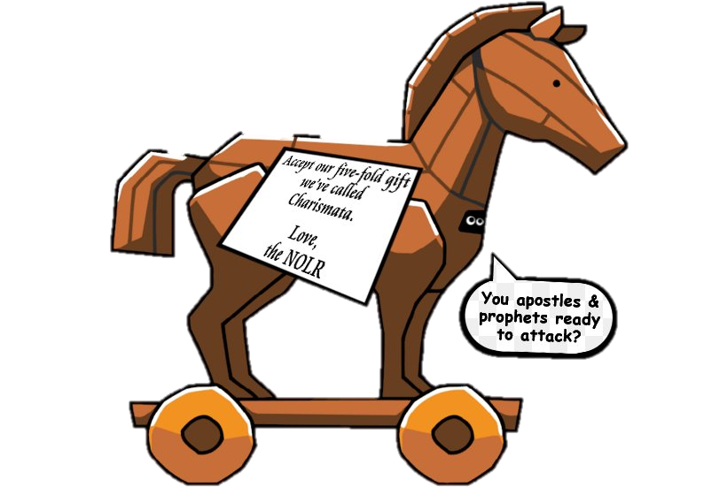
Trojan Horse
A Trojan Horse is a program containing malicious or harmful code.
Entering a computer, it performs various tasks like corrupting files and sending out personal information.

Slide 54
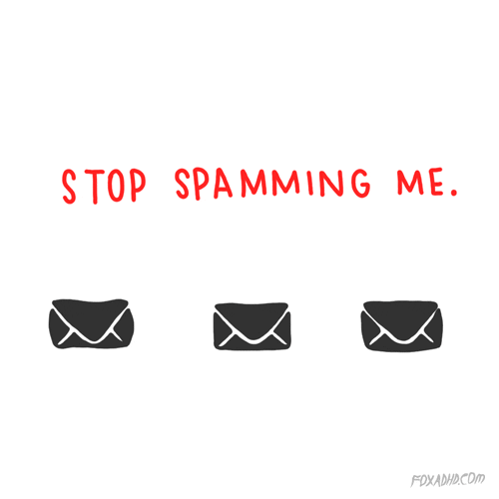
Spam
Method of flooding the internet with the copies of the same message
It is for the purpose of advertising, phishing, spreading malware etc.

Slide 55
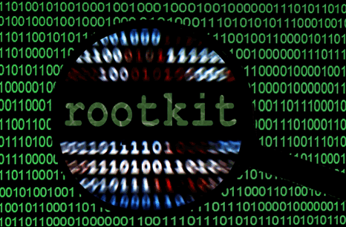
Rootkits
Software hidden deep inside your device which remains undetected.
It transmits all your sensitive information

Slide 56
What is Antivirus Program?
Antivirus Software is a computer program that identify and remove computer viruses, and other malicious software like Worms and Trojans from an infected computer. Not only this, an antivirus software also protects the computer from further virus attacks.
The first anti-virus software in 1987. Fix, a German astrophysicist and amateur computer programmer developed software to combat the first computer virus “in the wild," which means that the virus had escaped the confines of the lab or network .

Slide 57
Symptoms of Infected computer
1. Unexpected pop-up windows
2. Slow start up and slow performance
3. Suspicious hard drive activity
4. Lack of storage space
5. Missing files
6. Crashes and error messages
7. High network activity
8. Email is hijacked
9. Security attacks
10. Background Data Processing

Slide 58
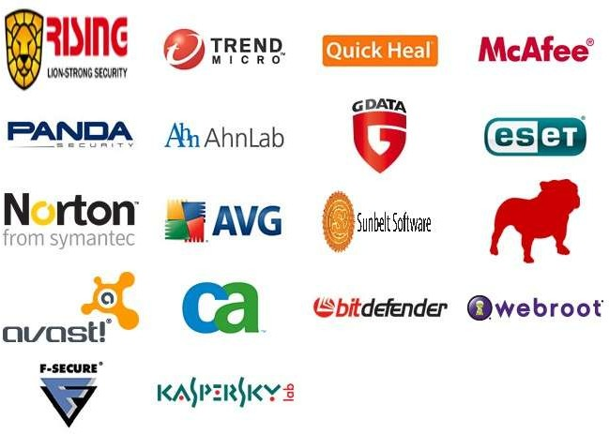
Some popular Antivirus:

Slide 59
12. Policies & Services in Operating System Windows 10

Slide 60
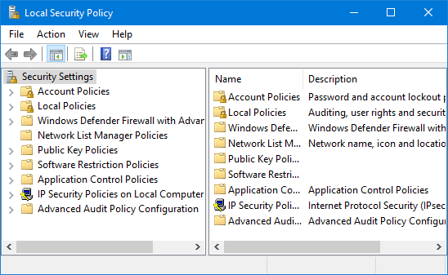
POLICIES?
Secpol is a way in which you can control various security policies and settings that define different behaviors on your Windows 10 computer. And it's a great way to ensure you have a standard security policy configuration across multiple computers if you don't have a domain.

Slide 61
Services?
Microsoft Windows services, formerly known as NT services, enable you to create long-running executable applications that run in their own Windows sessions. These services can be automatically started when the computer boots, can be paused and restarted, and do not show any user interface

Slide 62
13. Task Manager & RUN in Operating System Windows 10

Slide 63
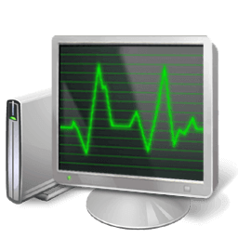
TASK MANAGER
A task manager is a system monitor program used to provide information about the processes and applications running on a computer, as well as the general status of the computer. Some implementations can also be used to terminate processes and applications, as well as change the processes' scheduling priority.

Slide 64
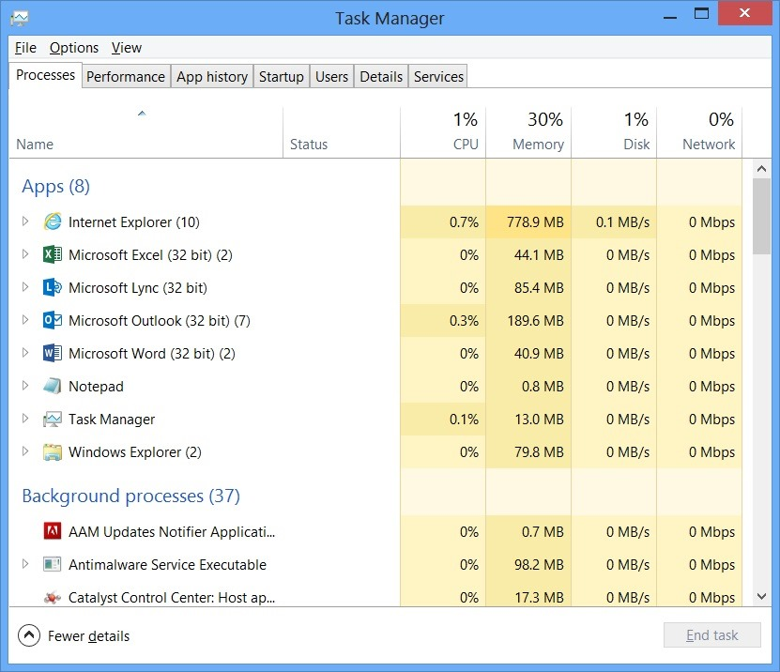

Slide 65
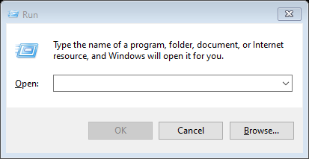
RUN Dialog Box
RUN Command Dialog Box is a Windows easy Utility Which works as like a Gateway to locate applications, services and Features in Windows OS. It can be Accessible by using shortcut command WIN+R. It is a Unique type of Utility Introduces in later Windows XP

Slide 66
14. Connecting to Internet all basic information you need

Slide 67
Connecting to Internet
Ethernet
Wireless LAN
USB Internet
Terms you may know
IP Address
Network Adapters
Wi-Fi Connection
Hotspot Connection
Default Gateway

Slide 68
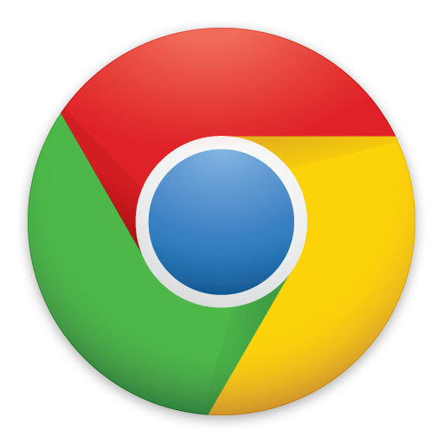
Google Chrome
Google Chrome is a cross-platform web browser developed by Google. It was first released in 2008 for Microsoft Windows, and was later ported to Linux, macOS, iOS, and Android where it is the default browser built into the OS.

Slide 69

Google Account
A Google account lets you log in on computers, smartphones and tablets using a single password. Google synchronises all your data from across all your devices, so things like email, photos and documents can be accessible wherever you are. There are a host of other benefits too, and best of all, it's simple to set up.

Slide 70
15. Connecting in Network & Sharing File using Network

Slide 71
Terms you may know
Network :- Group of two or more computers which are connected together are responsible to creating a network.
Sharing Folder :- Sharing a folder means you are sharing files to another computer by allowing to share from first one.
Simple Transfer :- Simple transfer refers to the process of sharing files to flash drives or disks using operating system.
Share via Internet :- It refers to sharing files via Internet by Uploading it best example is Google Drive.
FTP:- It refers to sharing files using File Transfer Protocol or FTP Server by hosting it.

Slide 72
16. Remote Desktop Connection & Windows Remote Assist.

Slide 73
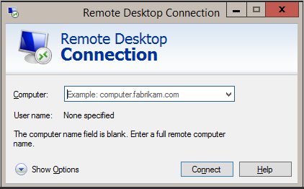
What is RDC?
A remote desktop connection allows you to use virtually any computer or device in order to connect to another computer. Once you connect remotely, you get access to all the resources on the computer you've connected to.

Slide 74
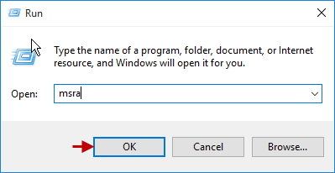
What is WRA?
Windows 10 feature, allows a user to temporarily view or control a remote Windows computer over a network or the Internet to resolve issues without directly touching the unit. It is based on the Remote Desktop Protocol.

Slide 75
17. Basic Understanding of Computer terms (FPS, dpi & RPS)

Slide 76
Terms
Video :-
FPS
Resolution
MP4, 3GP or MWV
Others :-
DPI
RPS
PPM or PPH
Refresh rate
MBPS or GBPS
Clock Speed
Frequency
Domain
KB, MB, GB & TB
File Extensions
Audio :-
Bitrate
Hz or Mhz
MP3, 3GP or WAV
Pictures :-
GIF
Transparent
Dimension

Slide 77
18. Backup & Restore Importance in OS with Practical

Slide 78
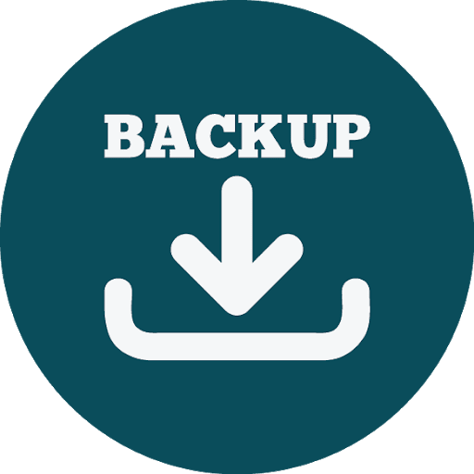
What is Backup
The simplest definition of a computer backup is an exact copy. In the case of computer files, we are referring to copies of the original files that you have on your laptop, desktop, or external drive

Slide 79
Types of Backup (4 types)
1. Full backups
A full backup is the most basic of all backup types. And as its name suggests, it’s also the most comprehensive. In a full data or system backup, all data is copied to another location.
2. Incremental backups
This type only backs up the information that has changed since the last backup occurred. Incremental backups are completed quickly and require fewer resources.

Slide 80
3. Differential backups
Similar to an incremental backup, a differential backup copies all data changed since the last full backup every time it is run. A differential backup provides a way of backing up changed data to the same convenient location as all new data.
4. Custom backups
This type of Backup allows you to backup anything which you want no restrictions here to the User.

Slide 81

Restore Windows
Windows Update is a Microsoft service for the Windows 9x and Windows NT families of operating system, which automates downloading and installing Microsoft Windows software updates over the Internet.

Slide 82
19. Migration of data Importance in OS with Practical

Slide 83
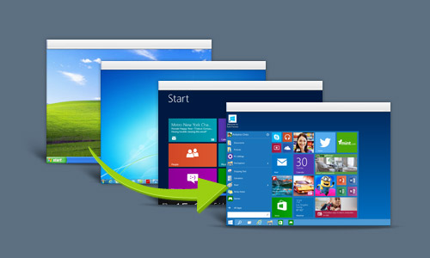
What is Migration?
PC migration is the process of transferring the entire user environment (e.g. personal documents and settings) between two computer systems.
The User State Migration Tool (USMT) 10.0 is an application intended for administrators who are performing large-scale automated deployments.

Slide 84
Tool we Need
USMT

Slide 85
20. What is Binary or Machine Language full information

Slide 86
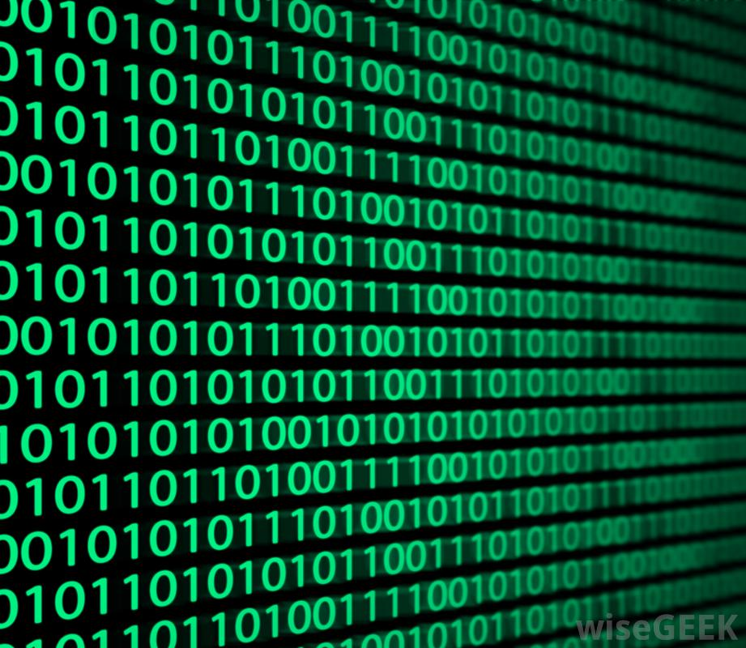
What is Binary?
Binary is a base-2 number system invented by Gottfried Leibniz that is made up of only two numbers: 0 and 1. This number system is the basis for all binary code, which is used to write data such as the computer processor instructions used every day.

Slide 87
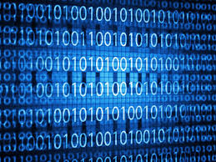
How does binary work?
The 0s and 1s in binary represent OFF or ON, respectively. In a transistor, an "0" represents no flow of electricity, and "1" represents electricity being allowed to flow. In this way, numbers are represented physically inside the computing device, permitting calculation.

Slide 88
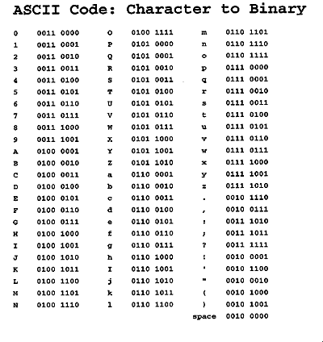

Slide 89
What is form of Data?
Data is measured, collected and reported, and analyzed, whereupon it can be visualized using graphs, images or other analysis tools. Data as a general concept refers to the fact that some existing information or knowledge is represented or coded in some form suitable for better usage or processing.

